Slide 1
A Student’s Guide to
Show My Homework

Slide 2
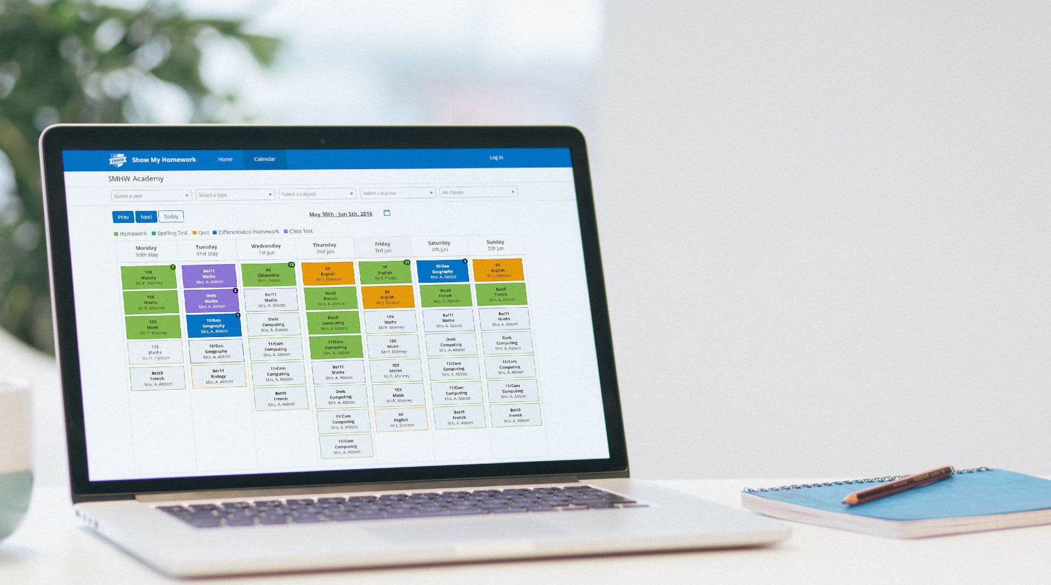
What is Show My Homework
Homework on your computer, phone and tablet!
A to-do list organises all your work for you.
Helps you manage your homework from wherever you are.

Slide 3
How Show My Homework can Help You
Keeping your homework organised
Sends you reminders for when homework is due
Helps show you how much homework you have
Keeps you up to date when you’re away from school
No need to write your homework down before leaving class
Let’s you message your teacher in private if you need help with your work

Slide 4
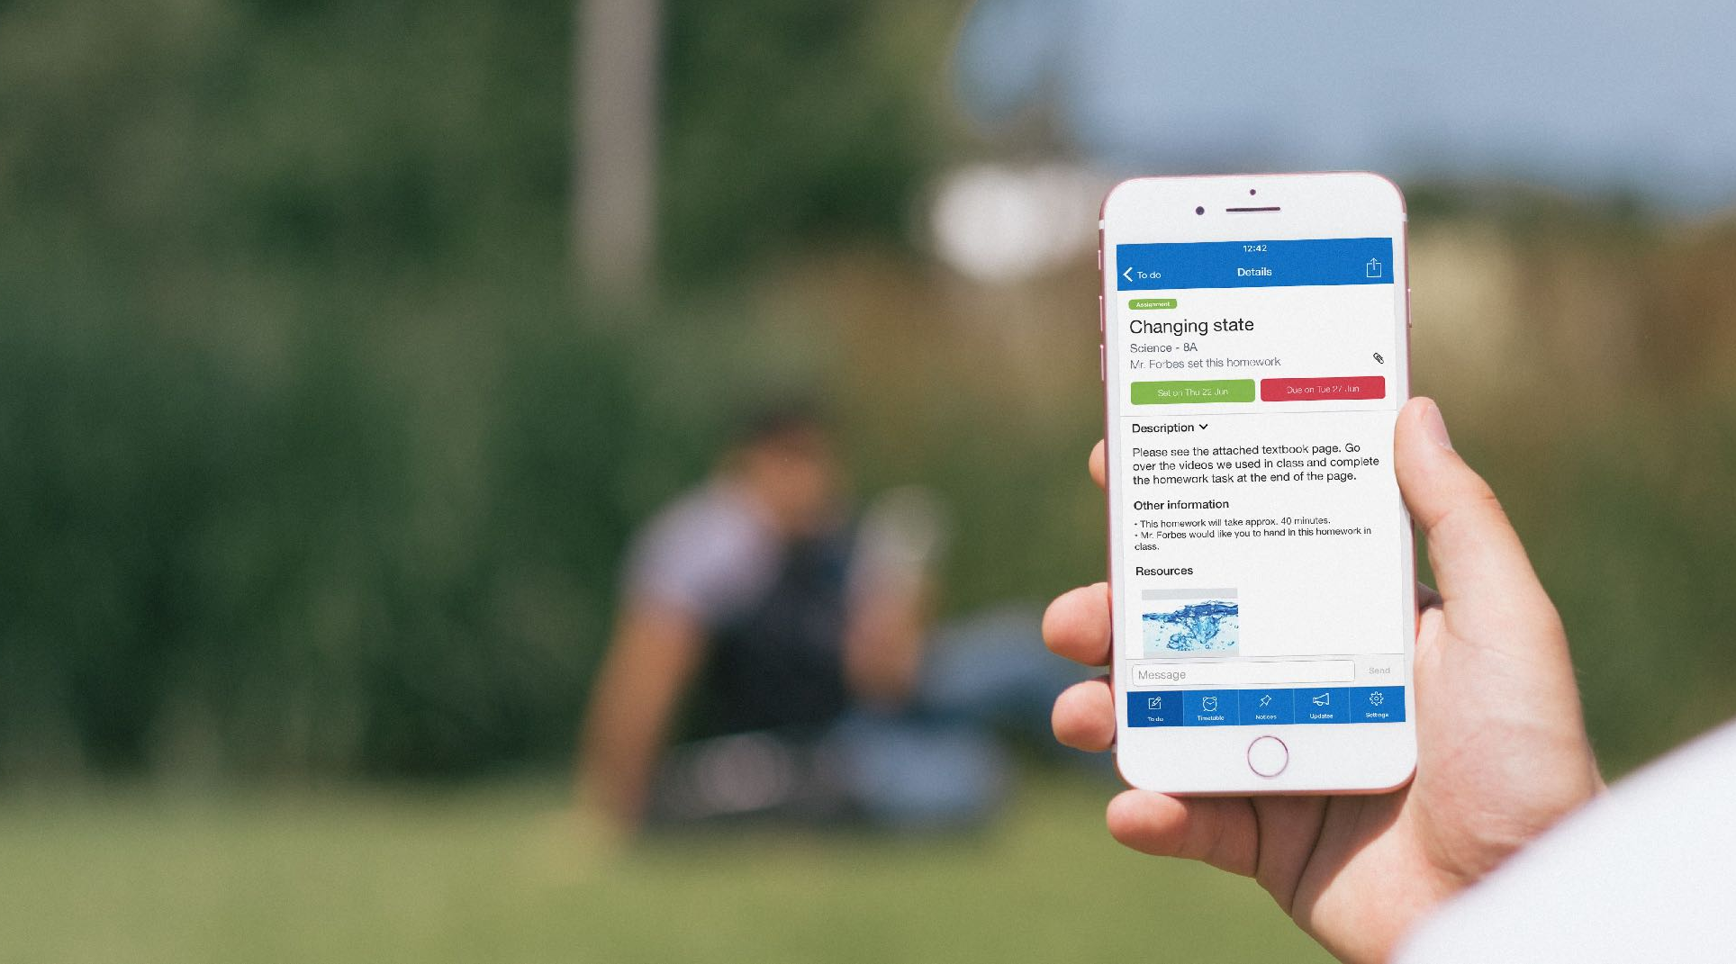
Homework Description
Your homework tasks are clearly laid out in Show My Homework with all the information you need to complete them.

Slide 5
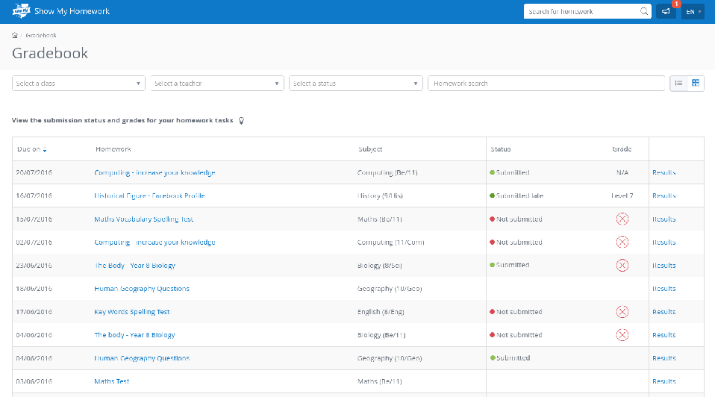
The Gradebook
Faster feedback from your teachers, including grades where required.
See comments from your teacher if they ask you to redo your homework and have the ability to reply.

Slide 6
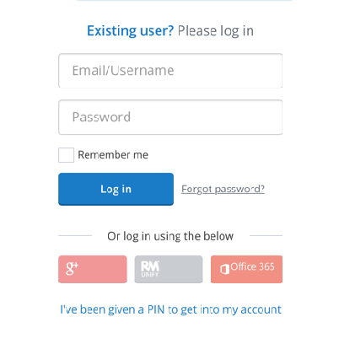
Getting Started
1
2
3
Have your letter ready, showing your PIN and enter this and your school name, tick the Captcha box and click “Submit”
Create a password and either enter your email address or press “I do not have an email address” and click “Update details”
You will now be able to login with your email/username and password you created

Slide 7
Downloading the App
Please all get your mobile devices out and download the Show My Homework App.
Open the app and type in your school’s name.
Type in your email/username and password.
You will be taken to your To-do List
You can start using Show My Homework on the go

Slide 8
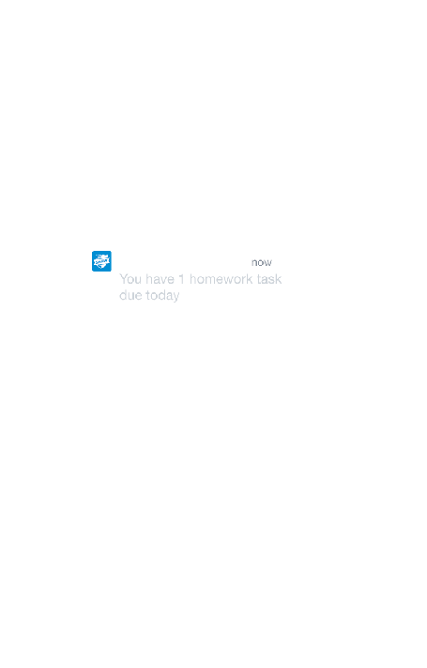
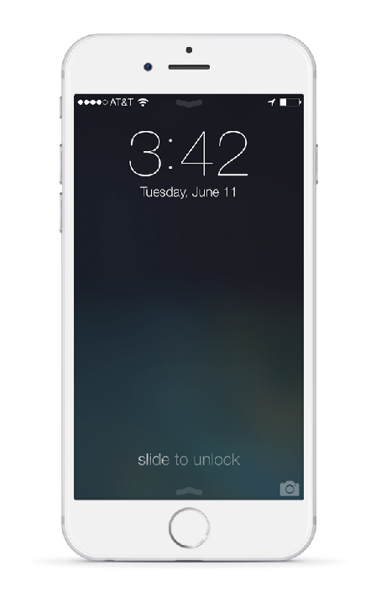
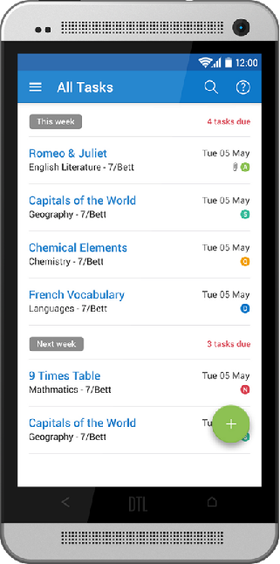
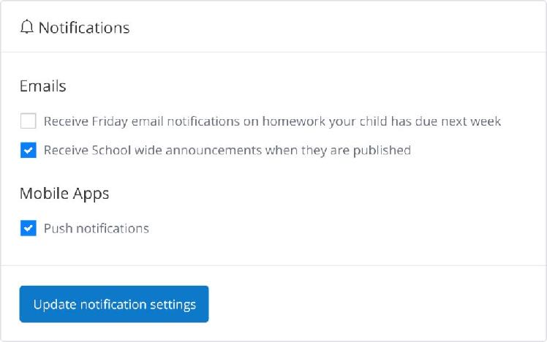
Get Notified
In Settings, you can manage notifications

Slide 9
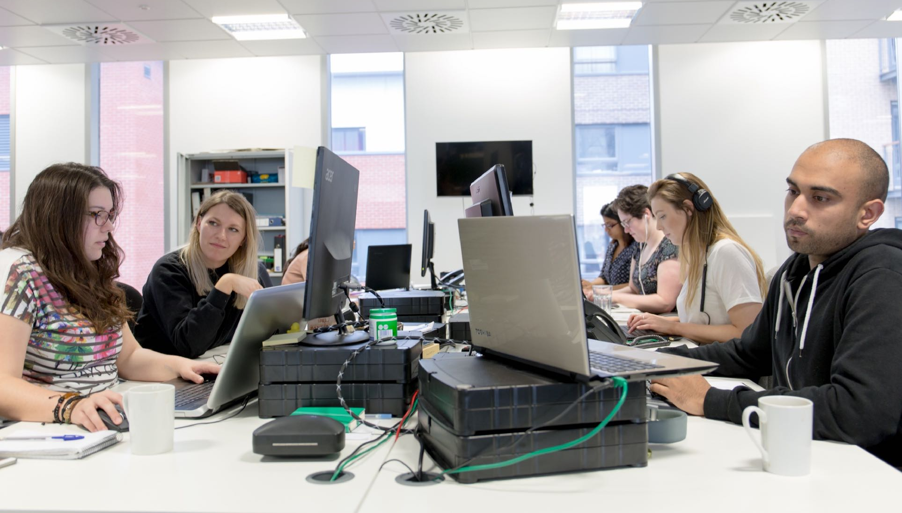
Support
Unlimited support for teachers, students and their parents from our highly skilled team of experts.
help.showmyhomework.co.uk
020 7197 9550

Slide 10
www.teamsatchel.com
0207 197 9550
help.showmyhomework.co.uk
@team_satchel

