Slide 1
A Teacher’s Guide to Show My Homework

Slide 2
About Us
Teacher Centric Limited
Based in East London
60+ Staff and growing
Award winning every year
All development work completed in house
The leading homework software for teachers and schools

Slide 3
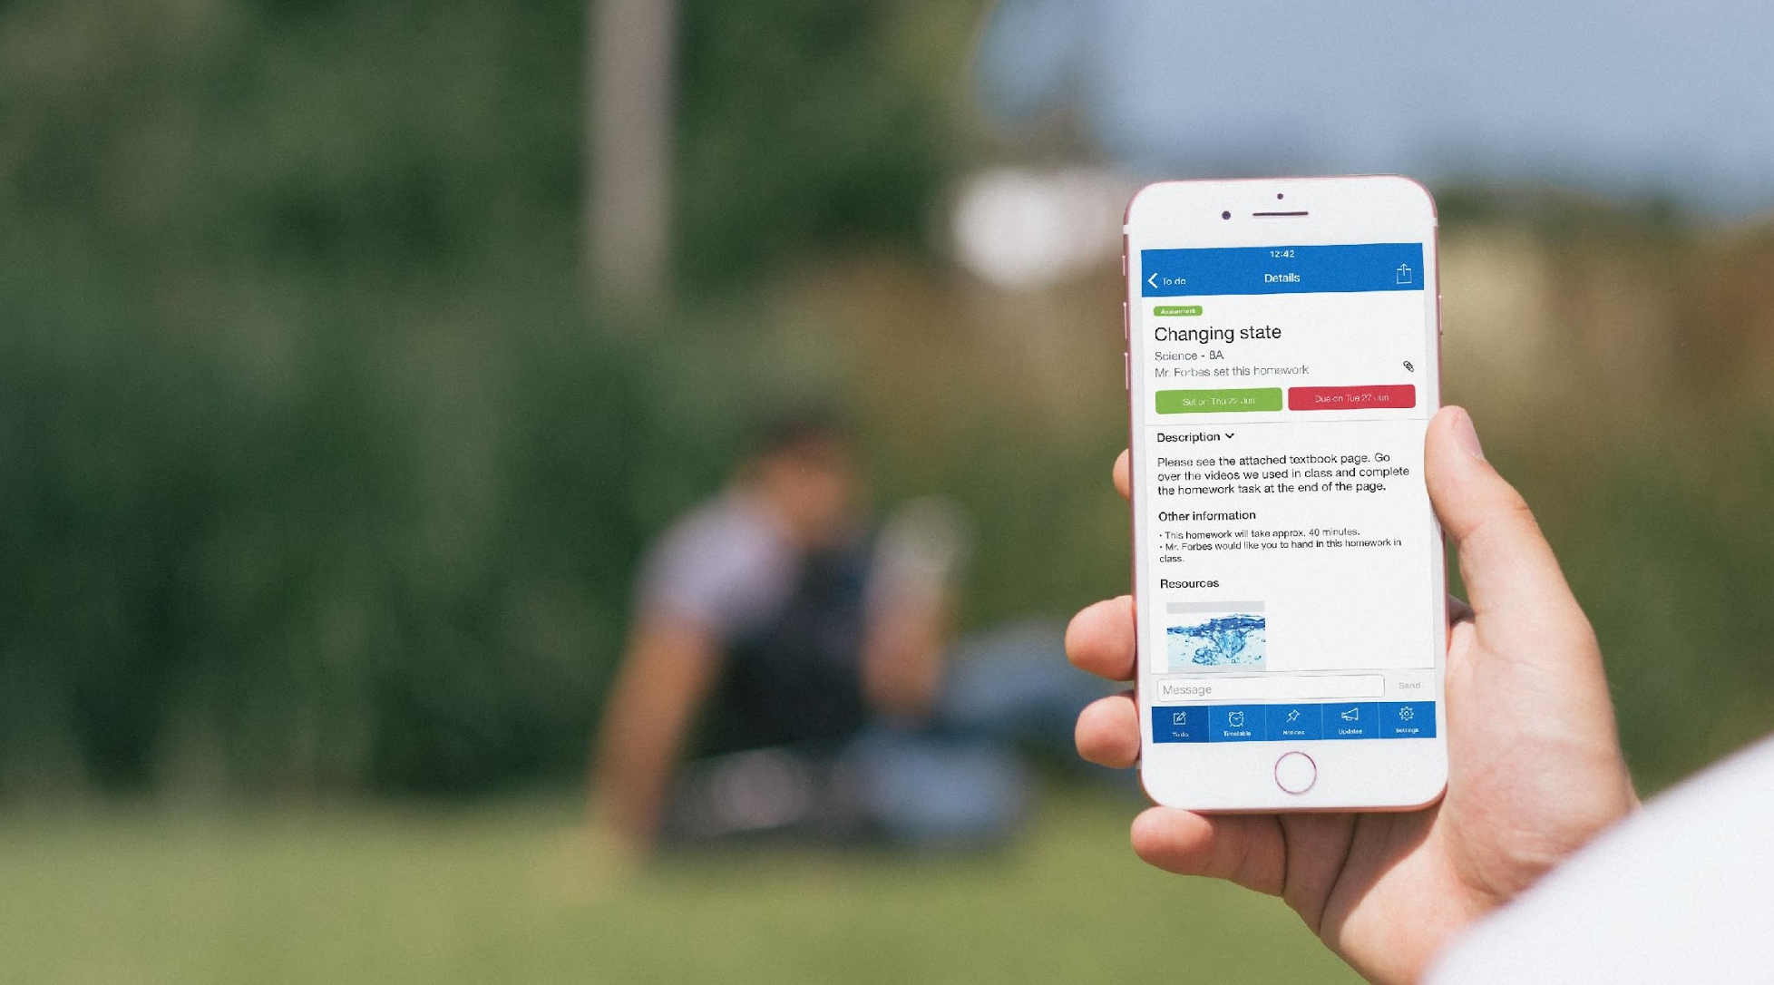
Show My Homework
A powerfully simple online homework software accessible on desktop, tablet or mobile. Teachers can create and set engaging homework and students can submit online and parents can track details and deadlines.
90%
Increased student engagement
100%
Homework setting consistency
95%
Time saved tracking and monitoring homework
95%
Customer support satisfaction

Slide 4
Benefits for Teachers, Parents & Students
Teachers
Transparency across the school.
Plan homework for the whole term quickly and easily.
Reuse quality homework.
No more excuses!
Students
Can see all homework at the click of a button.
A personalised experience to help stay organised.
Automatic due date reminders.
Students have more time to listen. (great for SEN students).
Can see homework that’s been set and take part in home learning.
More positive relationships with teachers.
Access to multiple students accounts from one profile
Better communication through school announcements.
Parents

Slide 5
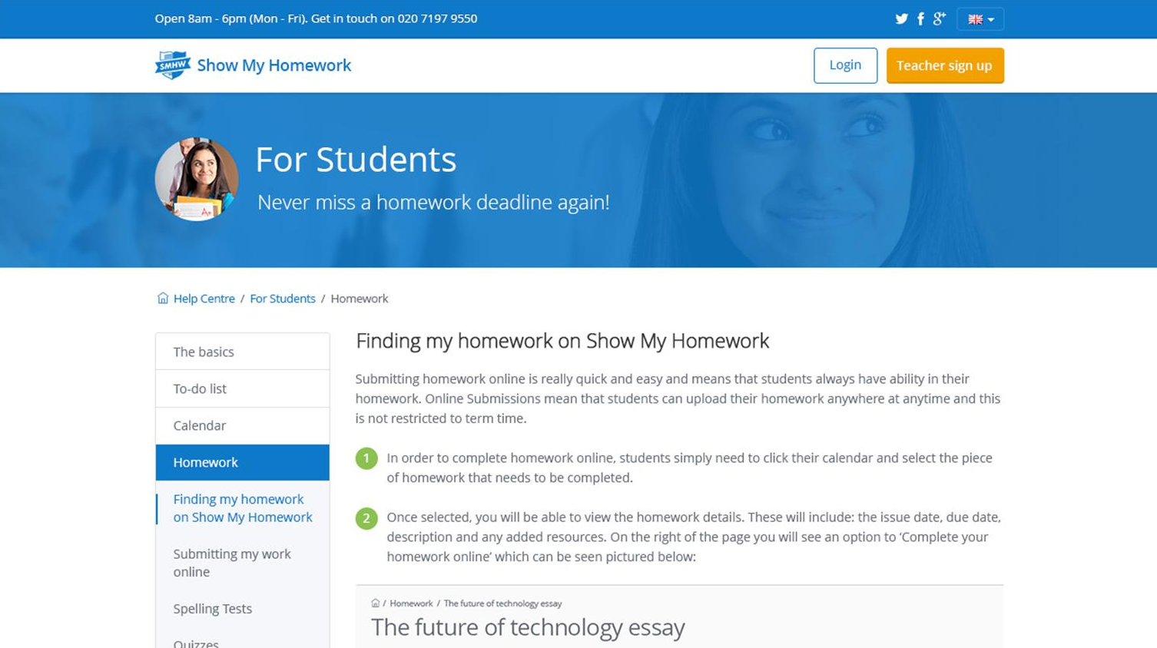
Our Help Centre
You can access our Help Centre at anytime through the left hand menu

Slide 6
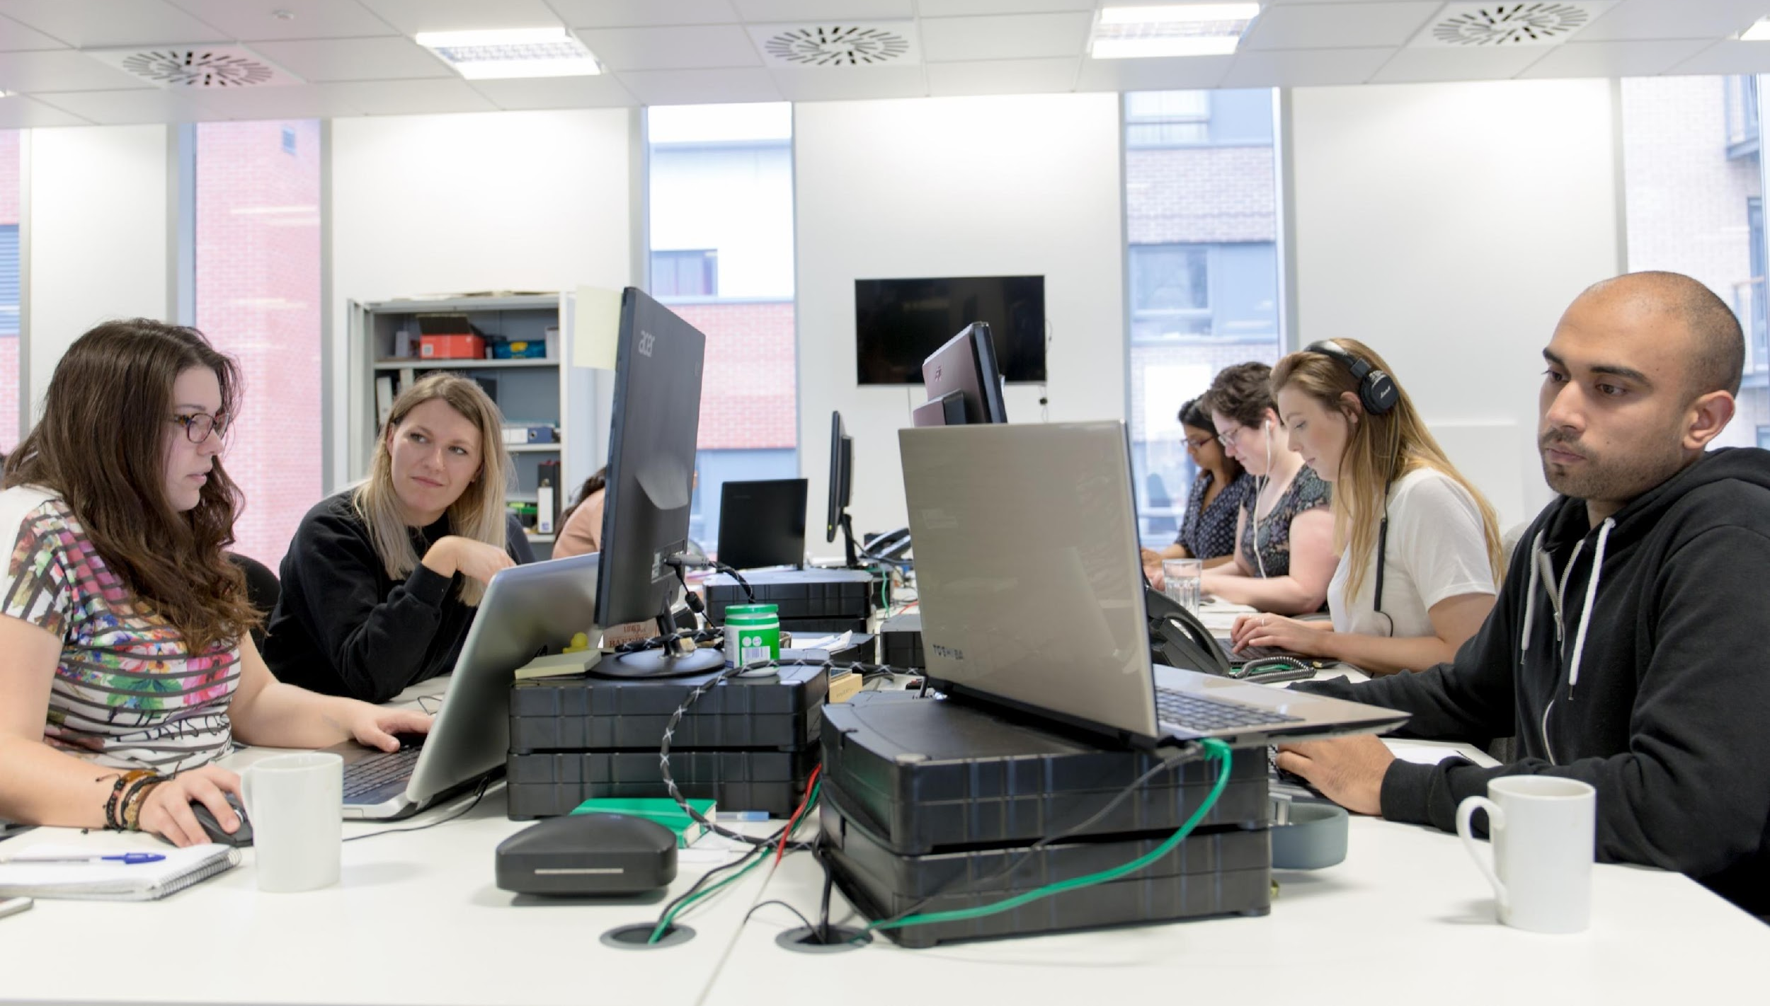
Support
Unlimited support for teachers, students and their parents from our highly skilled team of experts.
help.showmyhomework.co.uk
020 7197 9550

Slide 7
Logging in to Show My Homework

Slide 8
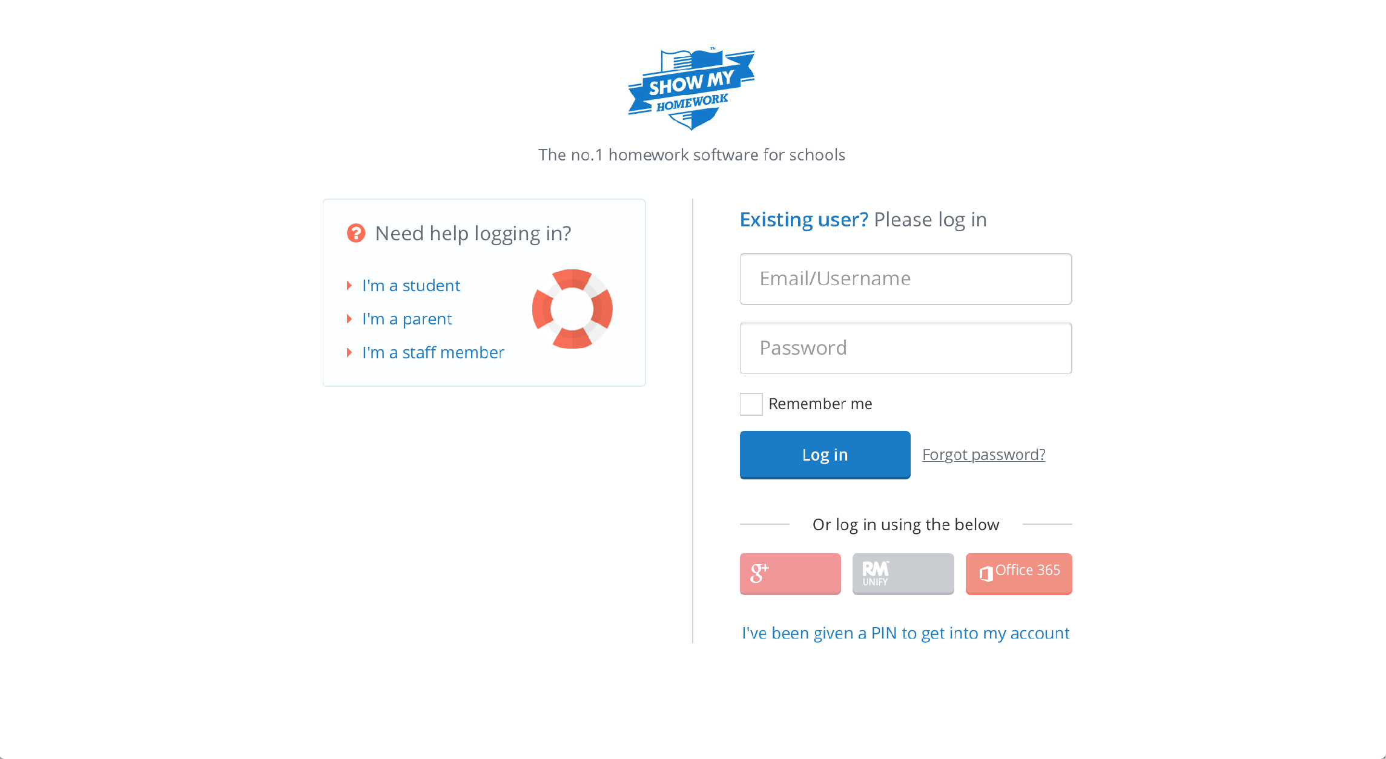
Logging in to Show My Homework
Username/Email: Your School Email
Temporary Password: Password

Slide 9
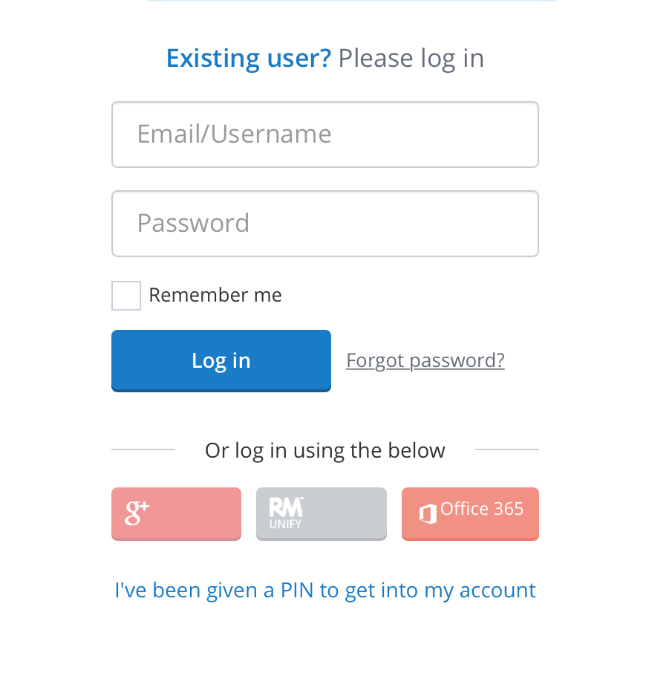
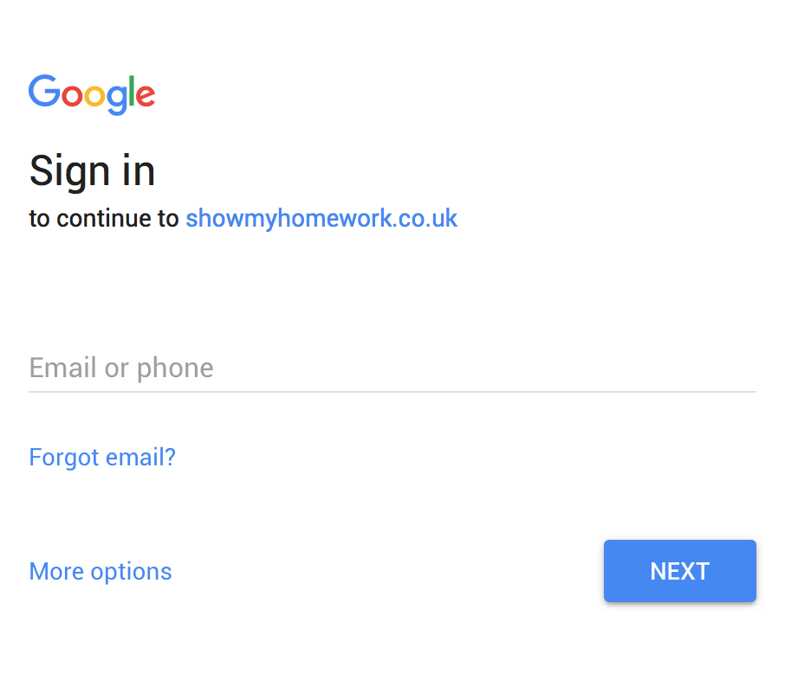
Logging in to Show My Homework
Access your SMHW account using your Google login

Slide 10
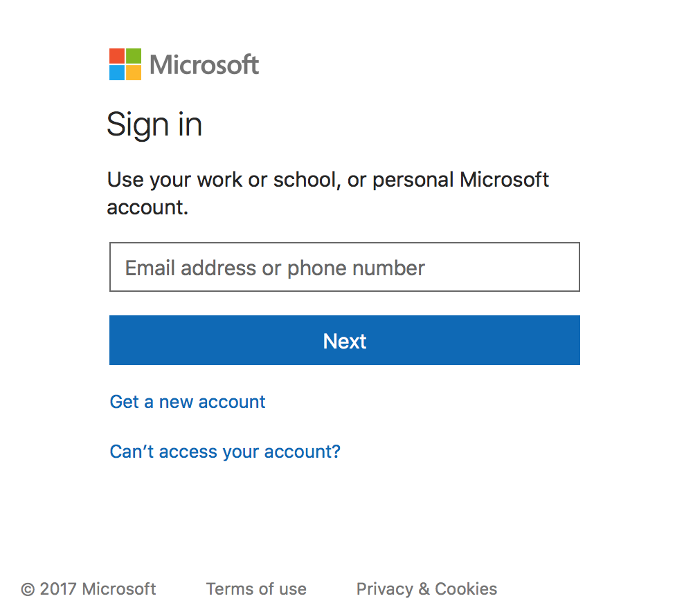
Logging in to Show My Homework
Login to your SMHW account with your Office 365 login

Slide 11
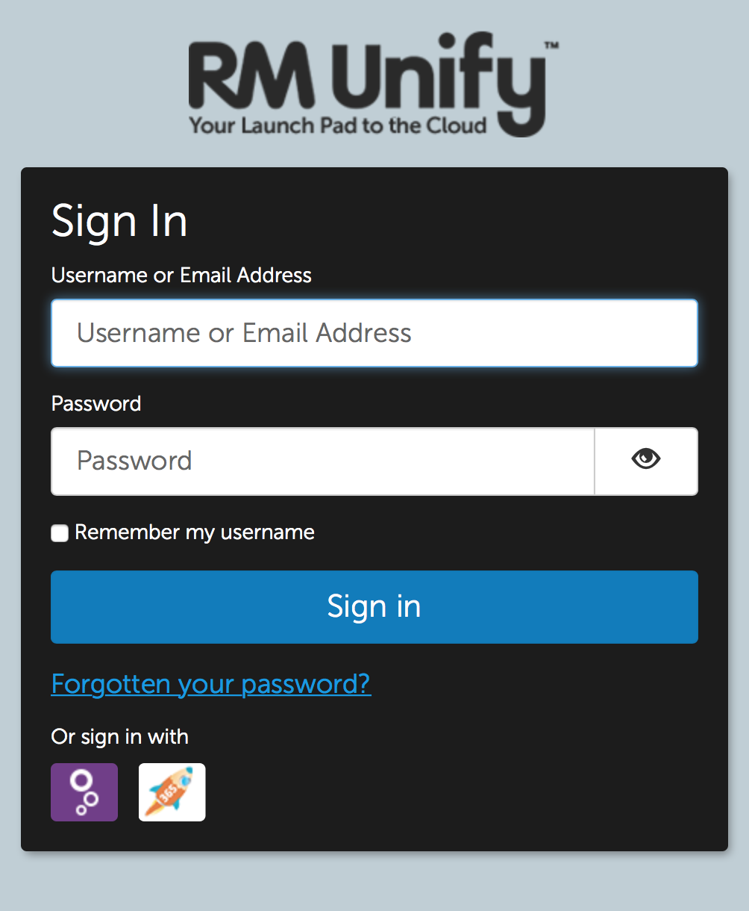
Logging in to Show My Homework
Access your SMHW account using your RM Unify login

Slide 12
Logging in to Show My Homework
Access your SMHW account using your Glow login

Slide 13
www.teamsatchel.com

