Slide 1
Guide to Getting Started with Show My Homework

Slide 2
About Us
Satchel
Based in East London
60+ Staff and growing
Award winning every year
All development work completed in house
The leading homework software for teachers and schools

Slide 3
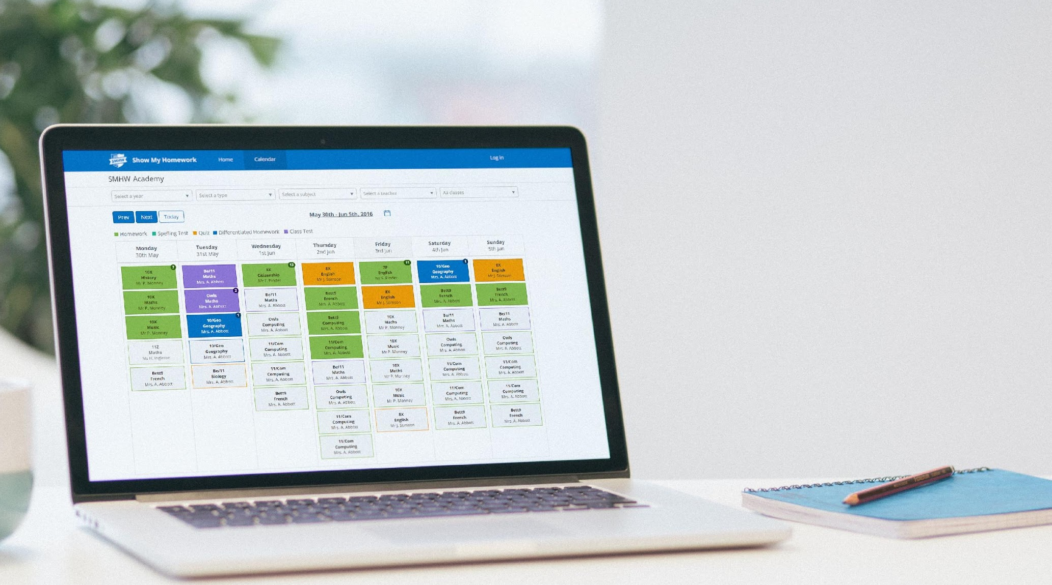
How We Can Help
We are your dedicated Show My Homework consultants, offering guidance to make sure our tool is successful at your school.
Implementing objectives and timelines
Setting up Show My Homework Champions
Providing resources and support
Aiming for a 75% engagement for all teachers in just 1 month

Slide 4
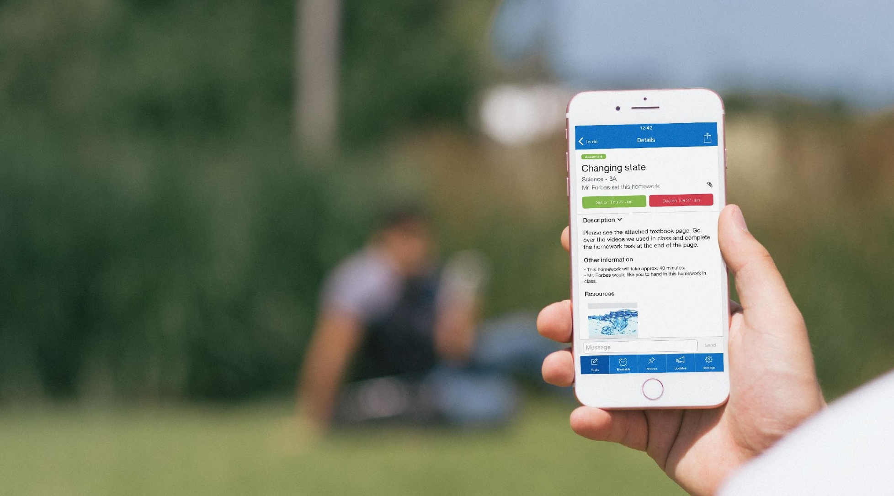
Our Promise
We know that every school is different so we tailor every plan to suit your needs.
Personalised launch and implementation plan
Experienced advice to drive engagement
Direct line of contact
Regular communication
Continued support

Slide 5
Setting Your Objectives
It’s critical to explain the “why” behind changing people’s behaviour – teachers, parents and students. Think about the original reasons why you wanted to introduce Show My Homework:
Student excuses/ Hand in rates
Parental engagement
Monitoring consistency of homework
Improving quality of homework
Student workload

Slide 6
Success Process
Planning
Roll-Out
Embedded
Technical setup
Roll-out plan
Homework policy
Materials prepared
Teacher training
Teachers set homework
Students and parents
Communication
Send login details
Consistent homework set and submitted
Parents engaged
SLT get better reporting

Slide 7
Key Roles In School
It will take more than one of you to introduce a change in behaviour for the school to be successful. Here is how different departments can help.
Role | Responsibility
Network Admin | Technical setup of SMHW. Works with the Onboarding team and after setup, goes via the Support team for any technical issues.
Heads of Department | Supports Assistant Head in introducing the SMHW to faculty. Works with SLT throughout the year to track usage and help teachers who are struggling.
Parental Engagement Lead | Supports Assistant Head in communicating logins to parents. Runs sessions with parents throughout the year to get them using the system. Monitors parental engagement.
Form Tutors | Gets students logged into SMHW for first time. Keeps track of homework for each student throughout the year by running reports.
Homework Champions | Supports teachers who need help using the product or learning advanced features. Can also support students or parents who need help as well.

Slide 8
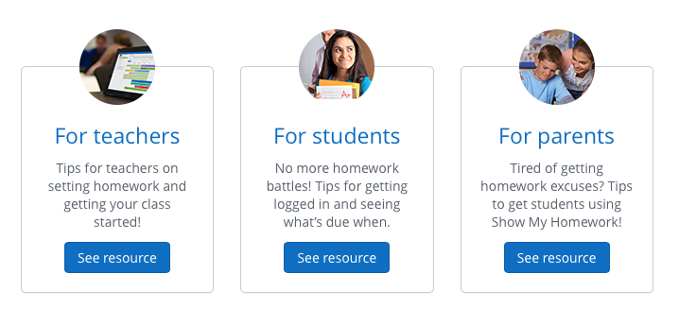
Resources
Resources are available at the click of a button
Introduction for parents
Tutorial videos
Login instructions
Parent pack
Introduction for teachers
Tutorial videos
Homework policy
Getting started guides
Introduction for students
Tutorial videos
Login instructions

Slide 9
www.teamsatchel.com
0207 197 9550
help.showmyhomework.co.uk
@team_satchel

